Slide 1
How Mindsets Affect our Perceptions and Behaviors
@BrandonRockhold

Slide 2

https://amzn.to/2icCNey

Slide 3
The Fixed Mindset:
The belief that one’s talents and intelligence are largely fixed
(you’re either both with it or it’s not meant for you)

Slide 4
The Growth Mindset:
The belief that one’s talents and intelligence can be cultivated through effort, experience, and mentorship
(your potential is unknown)

Slide 5
The End!?!
Short and Sweet...

Slide 6
Not so fast!
Let’s look a bit more deeply...

Slide 7
Doubts?
Let’s squash ‘em...

Slide 8
Is it scientifically possible to grow our intelligence?
The answer, thankfully, is Yes!
Studies on brain neuroplasticity have shown that our brains (even as adults) are able to reorganize and form new synaptic connections, and to even increase the thickness/density of our gray matter through time spent learning/practicing/training.
Note: gray matter includes the brain regions responsible for memory, decision making, and self-control (among other functions)
These brain changes are shown to lead to improved performance in the areas being trained.

Slide 9
Is it possible to change which mindset I use?
Again, the answer, thankfully, is Yes!
Dr Dweck references numerous studies indicating this is possible… and also easy.
By learning about these mindsets today, you are equipping yourself with the tools you need to be able to determine which mindset you are using and to potentially change your thoughts/actions as a result.

Slide 10
Sweet!
Now let’s dig in...

Slide 11
How do these mindsets affect how we think/act when facing success, failure, or new challenges?

Slide 12
Success through a Fixed Mindset
Success is…
...evidence of a person’s talents and intelligence
...validation that a person’s talents are worthy of recognition
...an indication that a person is special
Success contributes to a person’s self-esteem and ultimately becomes an identity: the person IS a “success” (rather than has taken action to be successful)
When viewed as an identity, being a “success” is a fragile way of thinking of one’s self

Slide 13
Success through a Growth Mindset
Success is evidence of a person’s hard work in a particular area of focus
Success IS NOT an identity: the person has taken actions to be successful, but they ARE NOT a “success” as a result
This identity distinction becomes important in the face of failure...

Slide 14
Failure through a Fixed Mindset
Failure is…
...evidence that the person IS a “failure”
...proof that the person’s talents and intelligence are defective
...something that causes fixed mindset people to feel as though they are stupid, worthless, or “losers”
Failure must be avoided at all costs or else the person must come to terms with the fact that they are not as talented, smart, or superior as they believed themselves to be
Leads to devaluing failed goals, placing blame on external circumstances and people, or rationalizing that at least they’re still better off than many others
Failure may be an indication that the person just can’t do that <thing>

Slide 15
Failure through a Growth Mindset
Failure is…
...a wake-up call identifying a weakness
...a learning opportunity
...evidence that more learning, training, or effort is required to succeed
Failure does not define the person; it’s just something they’re going through and must learn from
Note: failure can still be painful for growth minded people; they just tend to overcome it better through motivation to become better
Failure is not an indication that something can’t be done at all

Slide 16
Opportunities/Challenges through a Fixed Mindset
Fixed minded individuals…
...want to guarantee success for themselves
...want to avoid failure at all costs
...are less likely to take on opportunities/challenges that will stretch their current capabilities
...are likely to opt for work that relies on capabilities they know themselves to possess
Given that talents and intelligence are perceived as being fixed and natural, they’ll also try to avoid anything that requires effort
If a person has to try hard on something, how could they possibly be good at it?

Slide 17
Opportunities/Challenges through a Growth Mindset
Growth minded individuals view new opportunities and challenges as a means for learning and growing
Even without the appropriate skills and knowledge now, given the appropriate resources, time, experience, and effort, they’ll likely feel as though they can succeed (and ultimately stretch their capabilities much farther than their fixed minded counterparts)

Slide 18
How do these mindsets affect how we interact with others in the workplace?

Slide 19
Interacting with Fixed Mindset Individuals
Fixed mindset individuals…
...inherently believe in their superiority and will try to show it
...may take actions to benefit themselves at the expense of others
...may engage in such actions as:
Information hoarding
Taking credit for the success of others
Placing blame for failure on others
Putting others down in an attempt to elevate their own standing
Sabotage those who pose a threat to their own standing
With a fixed mindset, individual success is more important than team/project success

Slide 20
Suffering through a Fixed Mindset Manager/Leader
Fixed mindset managers/leaders…
...would prefer to be viewed as geniuses with lots of helpers who carry out their own brilliant plans
...would prefer to create situations where things fall apart without their own heroic efforts and involvement
...are particularly susceptible to being blindsided by their own weaknesses (to the detriment of their whole team, organization, or even company)
...may view their own superiority as justification for treating others cruelly
With a fixed mindset, it’s all about the manager/leader rather than the team
A strong team would be viewed as a threat and would likely not be allowed to be formed or persist for long

Slide 21
Interacting with Growth Mindset Individuals
Growth mindset individuals…
...believe that each person they interact with presents an avenue for learning/growth
...respect and listen to the ideas and criticisms of others without feeling threatened
...are not threatened by working with others who are smarter or more talented than themselves
...are unlikely to take credit for the success of others or redirect blame
With a growth mindset, the success of others is not a threat to their own standing. Team success without individual recognition/praise is not a problem so long as the person had an opportunity to learn/grow.

Slide 22
Thriving under a Growth Mindset Manager/Leader
Growth mindset managers/leaders…
...will view the failures of others as opportunities to improve their org or processes rather than as cause for punishment
...will be less likely than their fixed minded counterparts in recognizing and addressing their own weaknesses
...will seek to foster the growth of those around them
...will view struggling associates as people in need of additional mentoring, resources, or time/experience rather than as failures to be cast out or fired
With a growth mindset, the manager/leader is comfortable taking a backseat to allow those who are smarter or more talented bring their skills to the table
They WANT to grow strong teams that can perform well without their involvement

Slide 23
What about our kids? What do mindsets teach us about how to interact with them?

Slide 24
Mindsets and Children
From a young age, kids tend to be primed with the fixed mindset
Parents, teachers, and coaches praise them for being smart or naturally talented in some subject or sport
Rather than develop a love for learning, they may strive for perfection and pleasing others (if they are one of the “smart” kids) or simply grow to not care about school/learning at all
Actions:
Praise kids for hard work/effort instead of intelligence
Redirect fixed mindset comments from them (it’s not that others are not smart/skilled, they just haven’t learned it yet or put in enough time/effort)
If something is easy for them, tell them you are sorry they didn’t have a chance to learn something new instead of validating their intelligence

Slide 25
Have you ever fallen into the fixed mindset as shown by the following questions/statements?

Slide 26
Watch out for these signs of the Fixed Mindset
I’m not good at Math (or whatever).
I wish I could be a good artist.
I always wished I could learn how to play (whatever) instrument.
If this relationship was meant to be, it wouldn’t be so hard.
If you don’t like how I’ve done this, maybe you should do it yourself.
You don’t know what you’re talking about, why should I listen to you?
I’m so proud of how smart you are.
This child is our artist, and this one is our scientist.
Effort is only necessary for people who aren’t smart or talented.
Some people are just born great leaders (or speakers or whatever).
This relationship is so damaged that it can’t be saved.
That person shouldn’t be working on that task… they’ll never figure it out.
After criticism or rejection, I feel judged, bitter, or vengeful.
If I don’t give this project my full effort, I’ll at least have a reason for why it wasn’t successful.

Slide 27
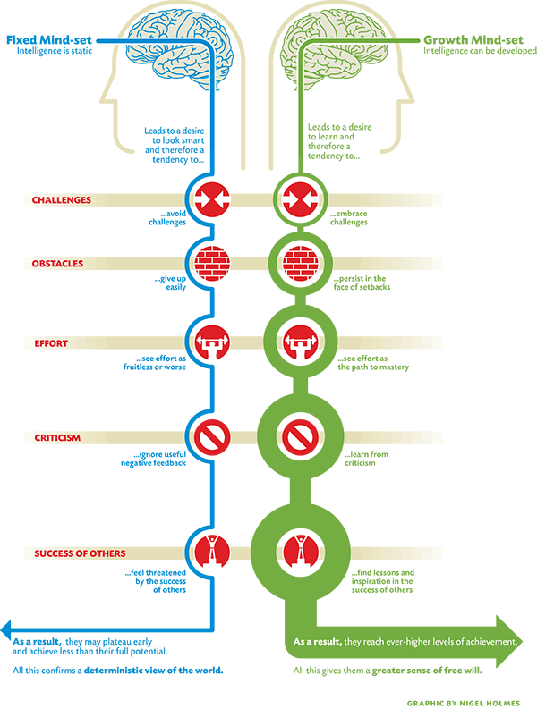
https://bit.ly/2KgHPX2

Slide 28
Thanks and happy learning :)

